Slide 1
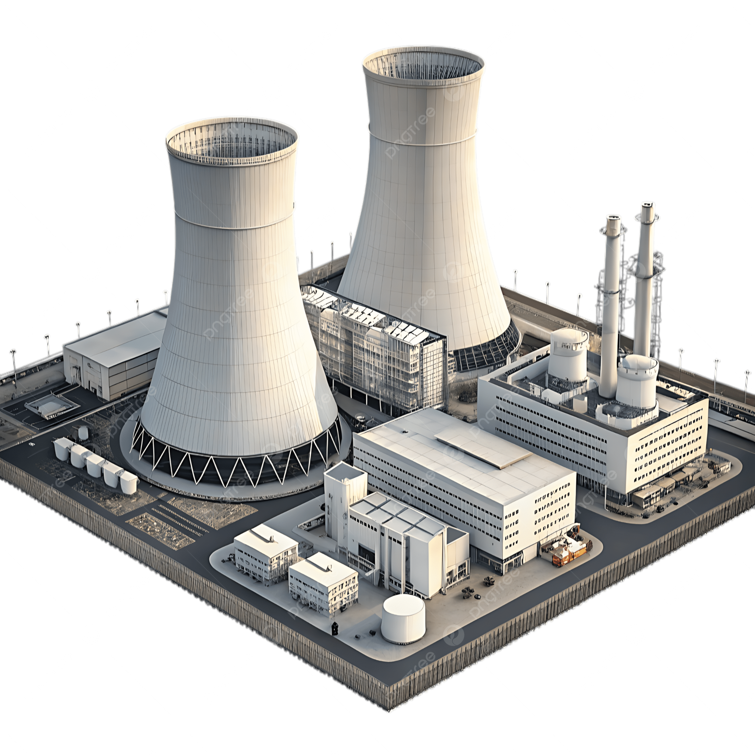


Nuclear Desalination
Using waste heat from nuclear
power plants to produce fresh water
Andrei Khazatsky, Jeremy Kwok, Joe Rosselli, Matthew Bell

Slide 2
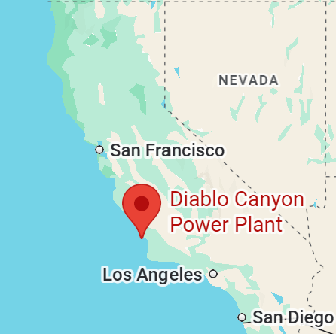
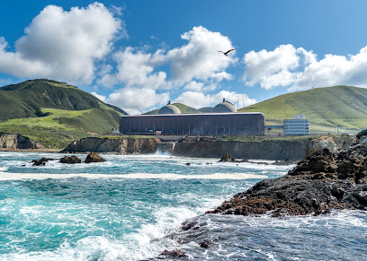
Real-World Modeling Basis
Diablo Canyon Power Plant
Why?
California water demand outpaces current supply
Plant is located on the coast with easy access to seawater
Key Specifications/Assumptions:
Seawater Temperature: ~20 C
Seawater Salinity: ~35 ppt
Brine Salinity: 85 ppt
Turbine Power: 1138 MW
Working Fluid Mass Flow Rate: 2296 kg/s
Wastewater Heat Rate: 4442 MW

Slide 3
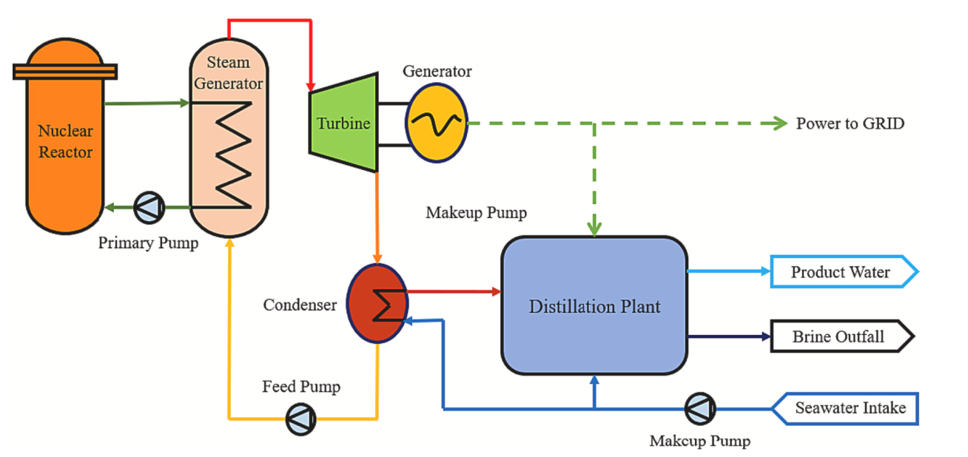
Overview of Design

Slide 4
Overview of design
Let’s zoom in

Slide 5
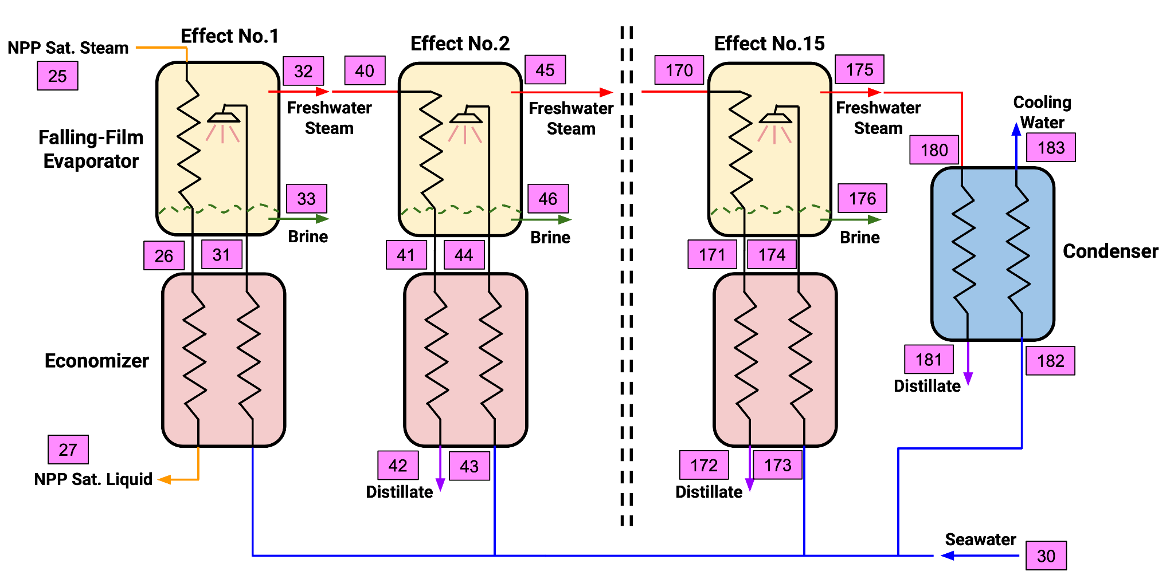
Multi-Effect Distillation (MED)

Slide 6
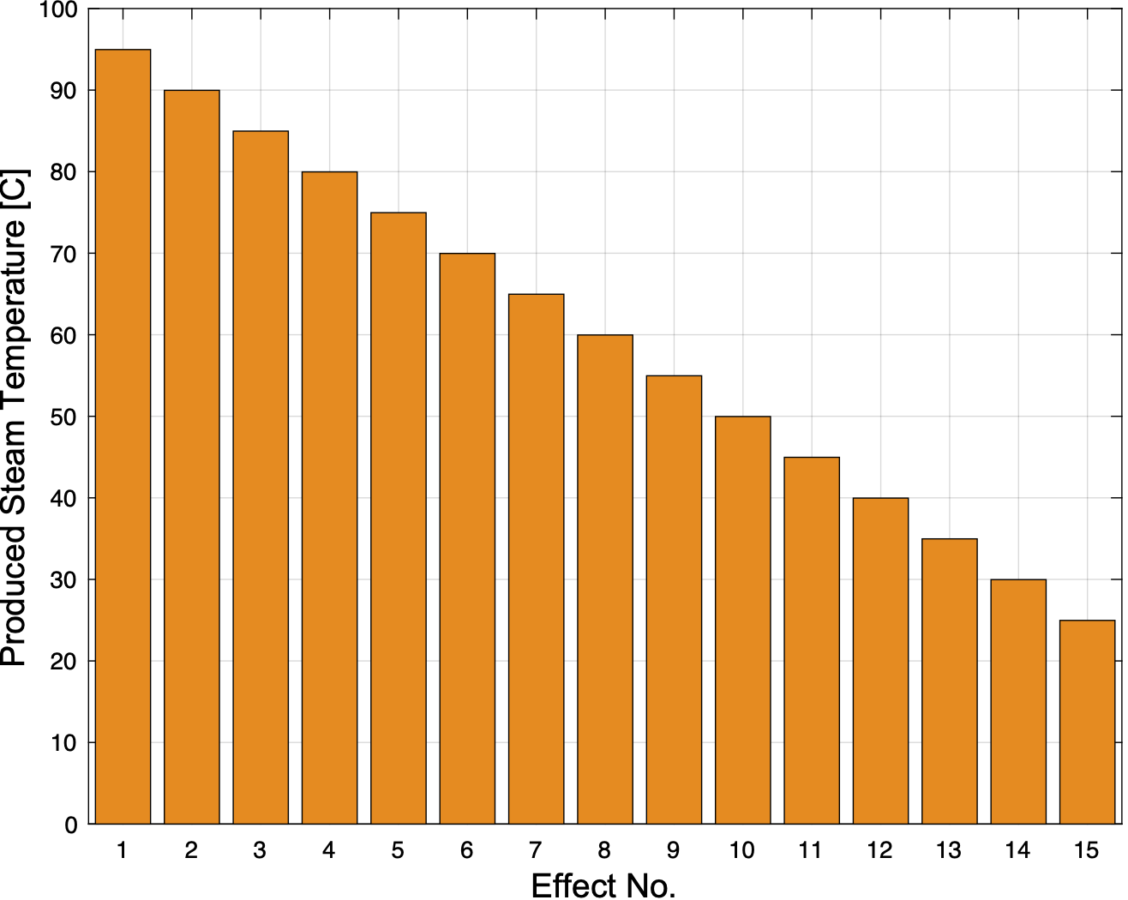
MED Design
Temperature in each Effect

Slide 7
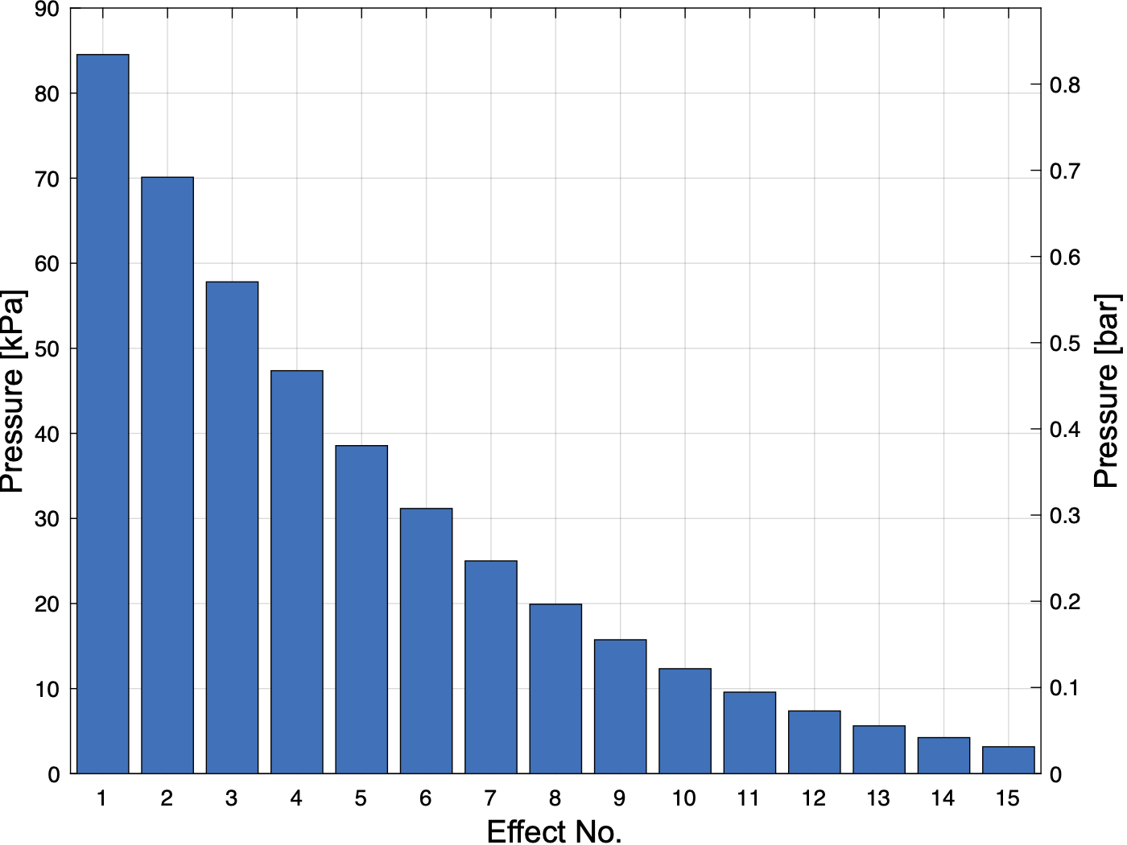
MED Design
Pressure in each Effect

Slide 8
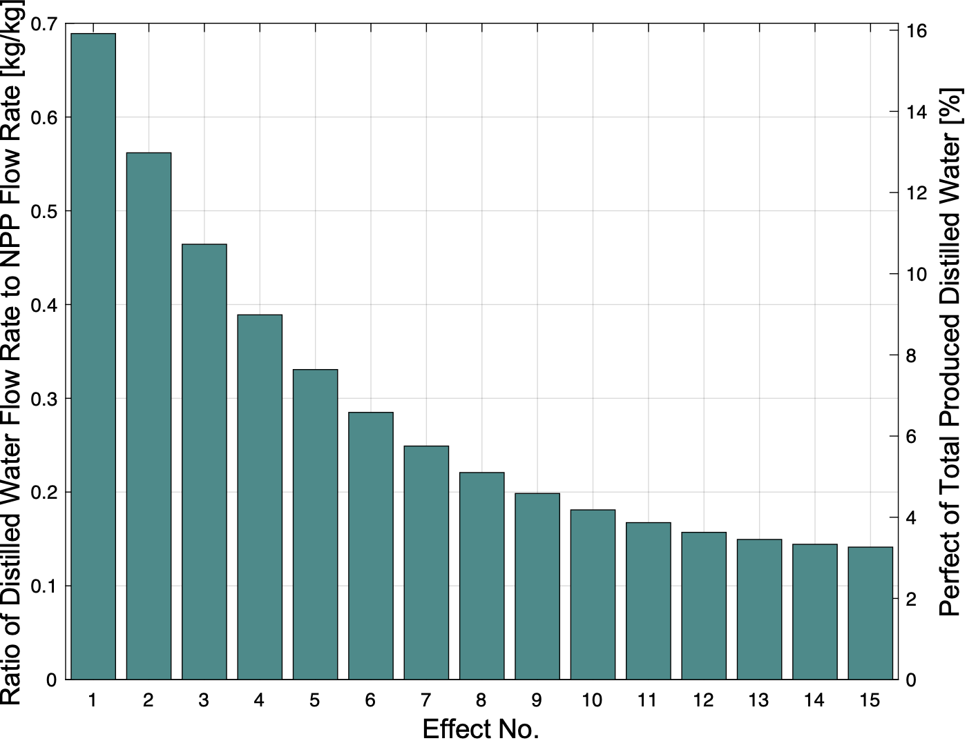
MED Analysis
Distilled Water Flow Rate in Each Effect

Slide 9
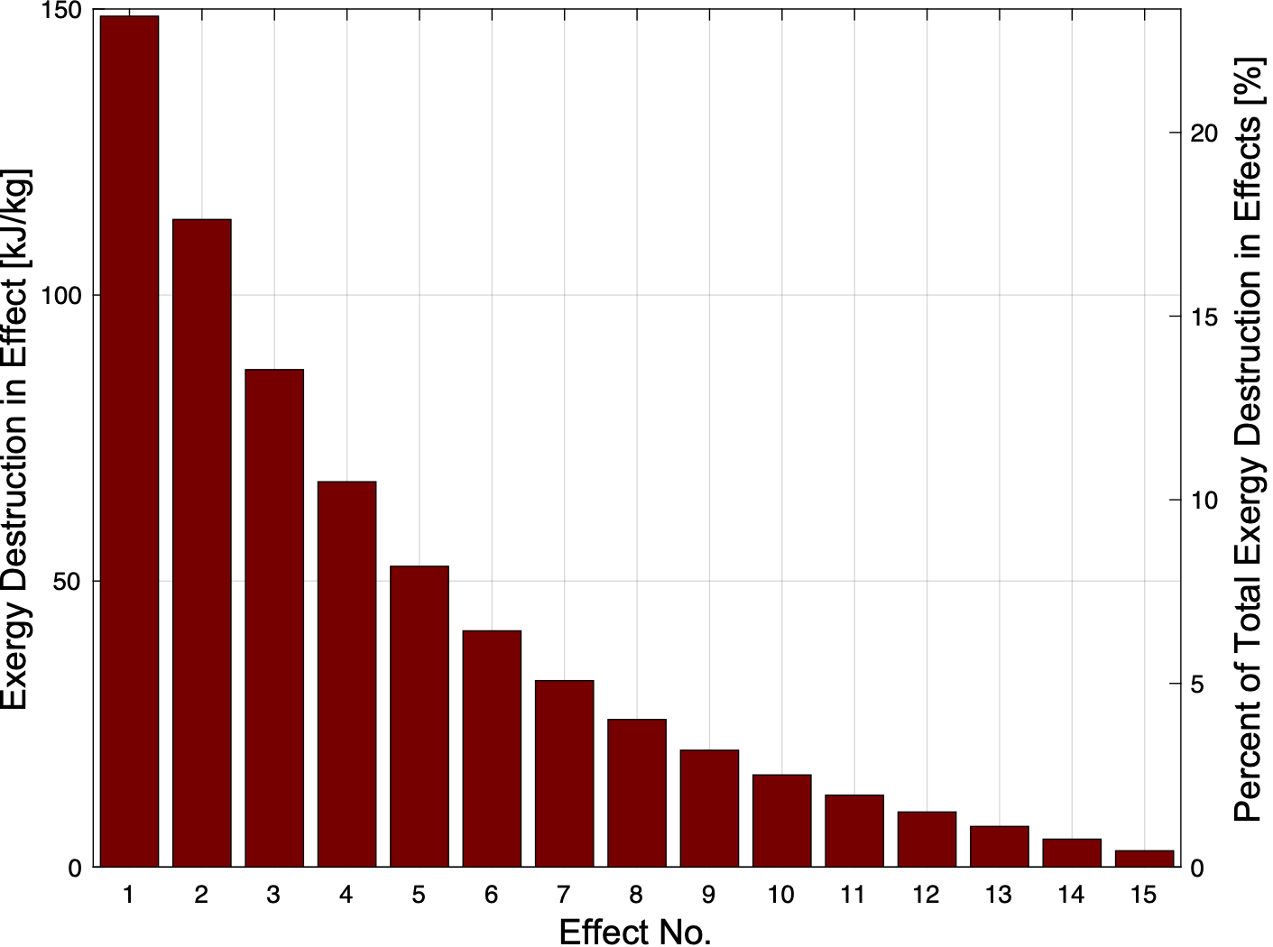
MED Analysis
Exergy Destruction in each Effect

Slide 10
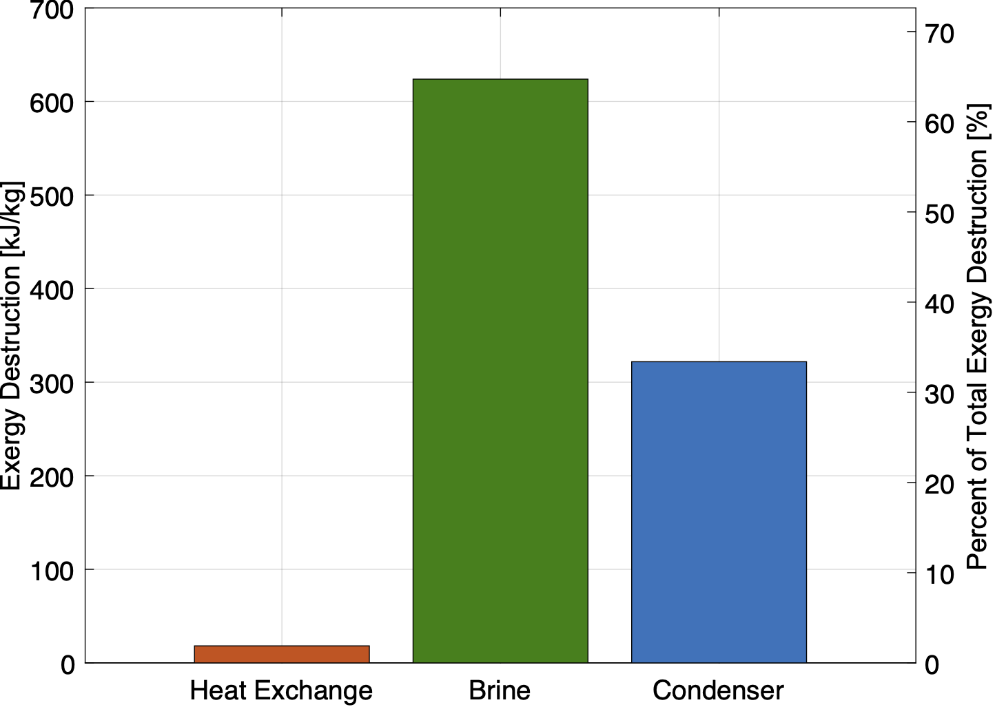
MED Analysis
Sources of Exergy Destruction

Slide 11
MED Analysis
Performance Metrics
Gained Output Ratio (GOR)
GOR_{mass} = 4.329 [kg/kg]
GOR_{hv} = 5.212 [kJ/kJ]
2nd Law Efficiency (η_{II})
η_{II} = 0.4736
Distilled Water Production for Diablo Plant
ṁ_{D} = 10,263 kg/s

Slide 12
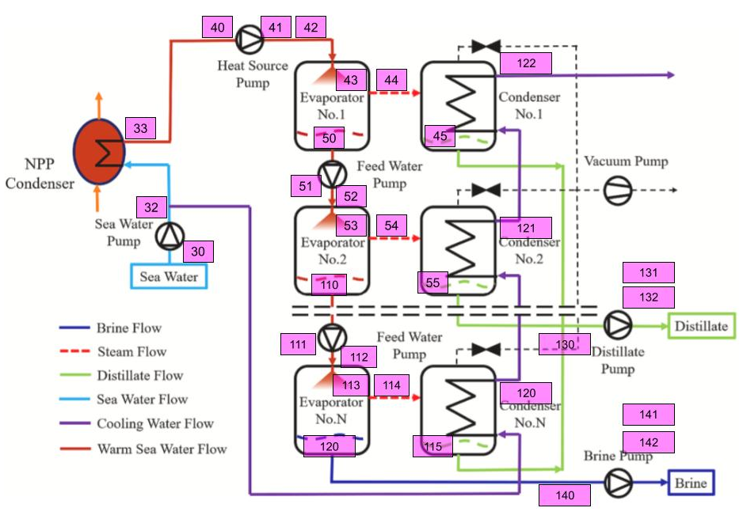
Spray-assisted Low Temperature Desalination (SLTD)

Slide 13
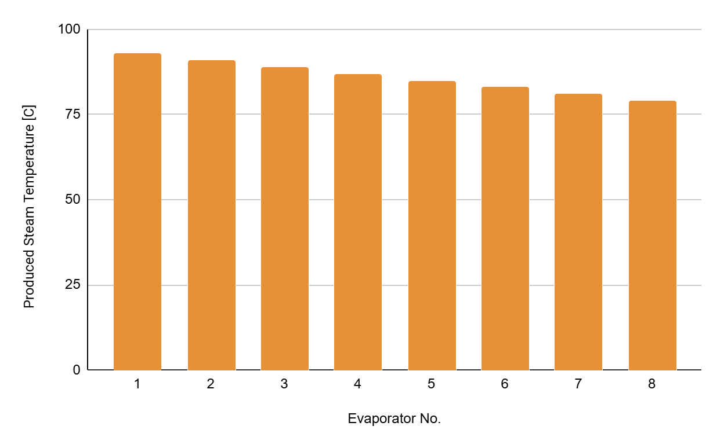
SLTD Design
Temperature in each Evaporator

Slide 14
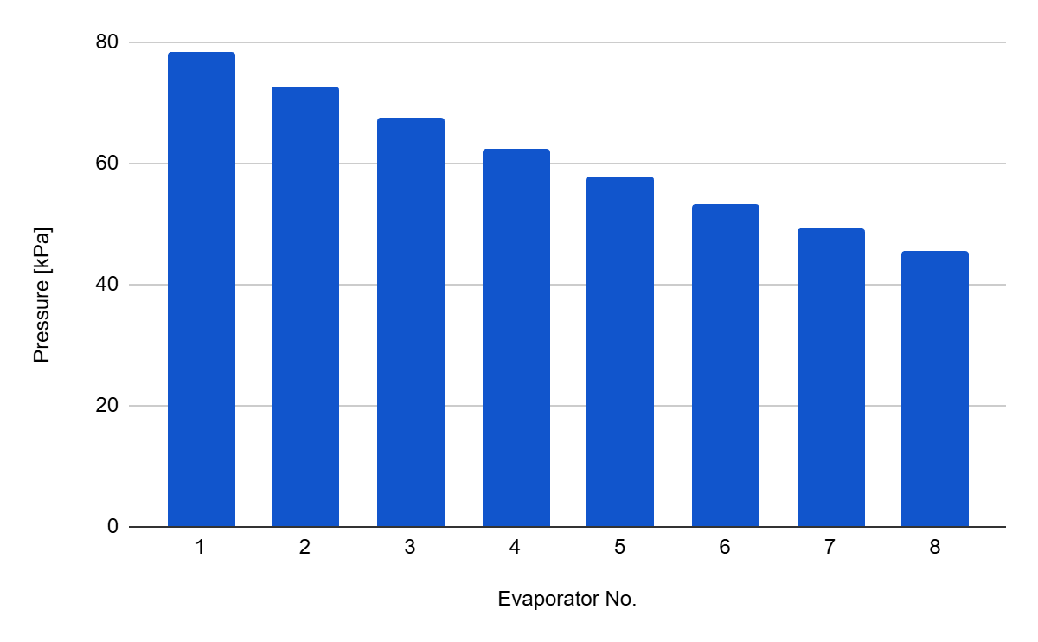
SLTD Design
Pressure in each Evaporator

Slide 15
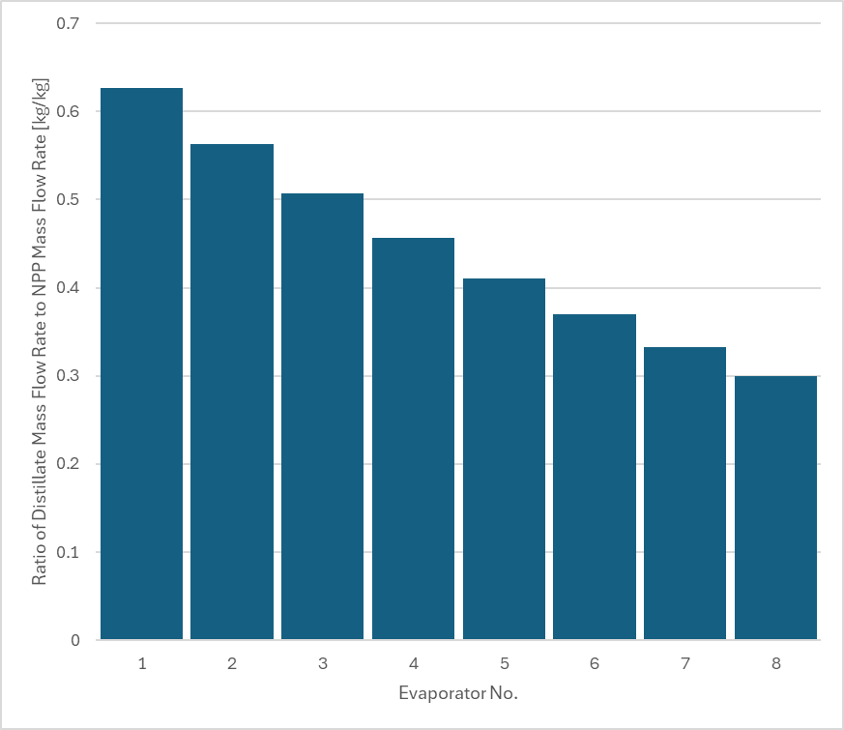
SLTD Design
Distilled Water Flow Rate in Each Evaporator

Slide 16
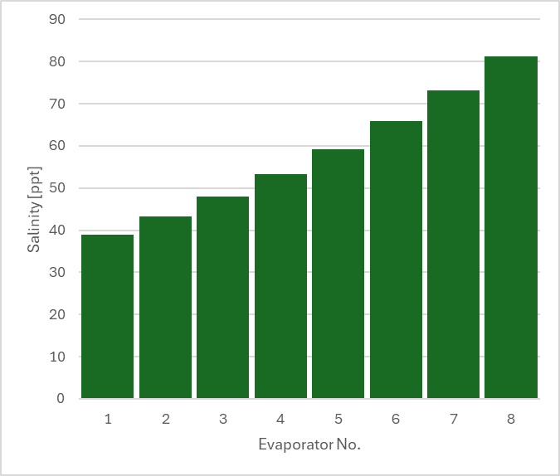
SLTD Design
Salinity in Each Effect

Slide 17
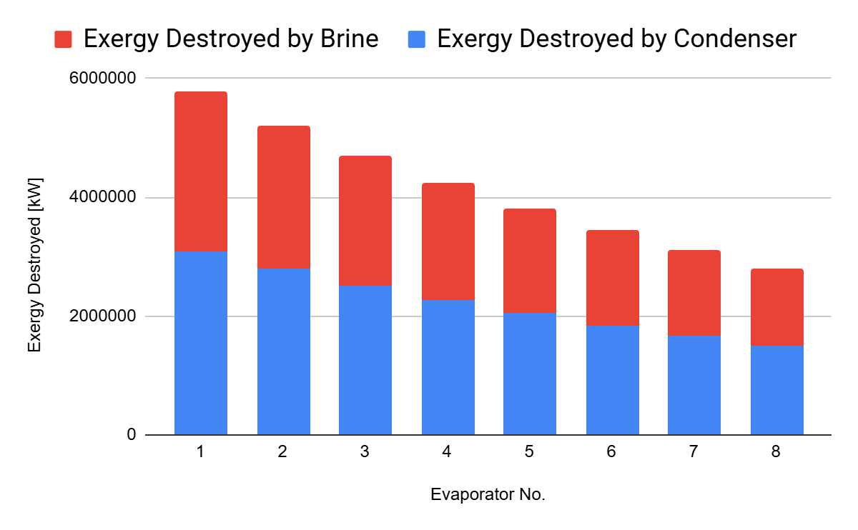
SLTD Design
Exergy Destruction in each Evaporator

Slide 18
SLTD Analysis
Performance Metrics
Gained Output Ratio (GOR)
GOR_{mass} = 3.57 [kg/kg]
GOR_{hv} = 4.10 [kJ/kJ]
2nd Law Efficiency (η_{II})
η_{II} = 0.4558
Distilled Water Production for Diablo Plant
ṁ_{D} = 8190 [kg/s]

Slide 19
Preferred Design: MED
MED
SLTD
Reasoning
Better GOR for both metrics
Higher 2nd law efficiency
Larger distillate mass flow rate
Simpler design
Reasoning
Experimental Technology
Lower distillate mass flow rate
Larger pumping requirements
Larger cooling seawater requirements

Slide 20
Cost Analysis
Using 25-year lifetime, 7% discount rate:
Base-case: LCOW ~0.62 $/m³ at ~0.9 million m³/day and 90% capacity factor
Notes:
“We did a Levelized Cost of Water analysis.
LCOW is annualized CAPEX + fixed O&M + variable O&M + electricity + thermal energy, all divided by annual water production.”
“For the MED + waste-heat design,
our state-point model gives about 0.89 million m³/day of product water and GOR ≈ 5, which corresponds to roughly 120 kWh of thermal input per m³.
We assume 1.5 kWh/m³ of electricity for pumps and auxiliaries, which is at the low end of reported MED values, and we treat the reactor’s condenser heat as zero-cost thermal input.”
“On the finance side,
we use a 25-year lifetime and 7% discount rate.
For CAPEX we assume $800M for the MED plant, which is about $900 per (m³/day), and $1200 per (m³/day) for RO—both inside published ranges for large seawater desalination plants.
Fixed O&M is 3% of CAPEX per year, variable non-energy O&M is $0.20/m³ for MED and $0.15/m³ for RO, and electricity is $0.07/kWh.
For RO we assume 3.5 kWh/m³, which is typical for modern SWRO.”**
“Putting that together,
our MED + waste-heat case has LCOW ≈ $0.62/m³: about $0.24 CAPEX, $0.08 fixed O&M, $0.20 variable O&M, and $0.11 electricity per m³.
The reference RO plant comes out to ≈ $0.82/m³: roughly $0.31 CAPEX, $0.11 fixed O&M, $0.15 variable O&M, and $0.25 electricity.
So overall our concept is about 25% cheaper per cubic meter, and you can see from the stacked bars that the main difference is electricity: RO spends around $0.25/m³ on power, while MED spends about $0.11/m³ and pays nothing for thermal input in this scenario.”**
“We also swept MED performance and capacity,
and LCOW only moves by a few cents—staying in the low $0.60s—so the result is fairly robust.
We’re honest that CAPEX is order-of-magnitude and waste heat is assumed to be truly free, but both LCOW values sit inside published cost ranges for large MED and RO plants, so the comparison is plausible even if the exact cents per cubic meter are uncertain.”**
Note on Realism/Effects:
GOR is basically how many kilograms of water we get per kilogram of steam. You raise GOR by adding more effects, but every extra effect is another big heat exchanger. That means more metal area and capital cost, and studies show that total area – and cost – grows faster than linearly with the number of effects. To use that properly we’d have to redesign the MED system for each N, (where N is the number of effects in the MED train) which is beyond this project. So here we fix one representative high-GOR design and focus on the LCOW comparison to RO, and we talk about the ‘more effects = more cost’ trade-off qualitatively instead of pretending we know exact dollars for 3 vs 15 effects.”

Slide 21
Questions?

Slide 22
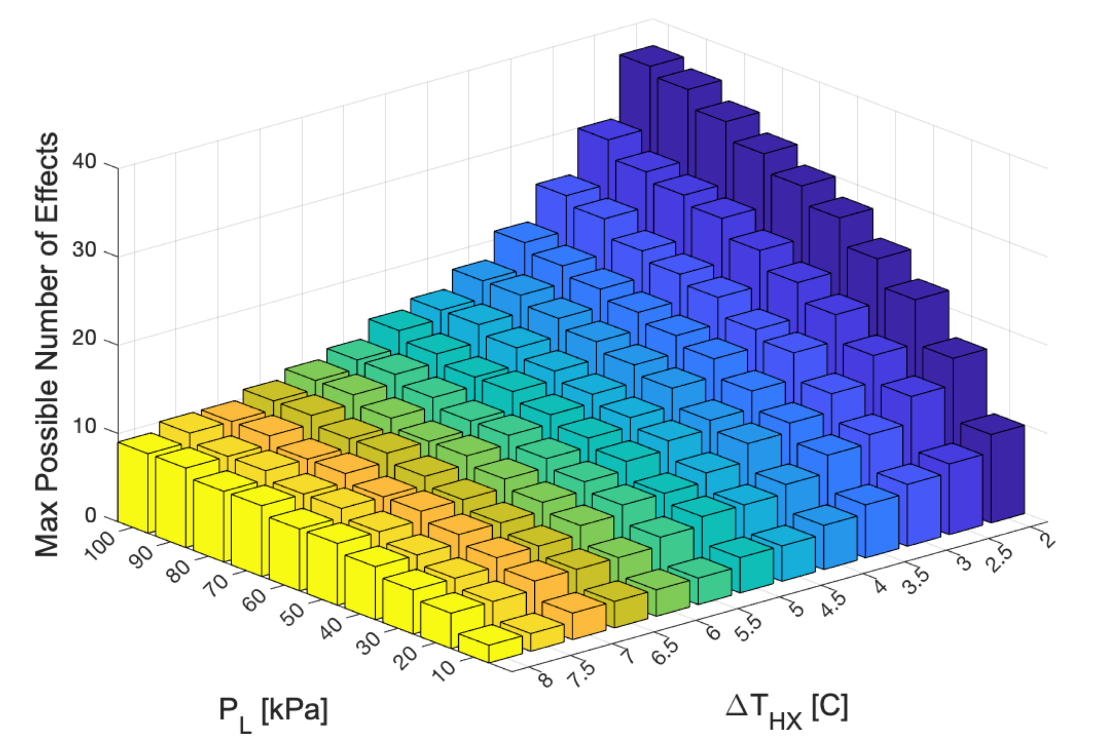
MED - Max Possible Number of Effects

Slide 23
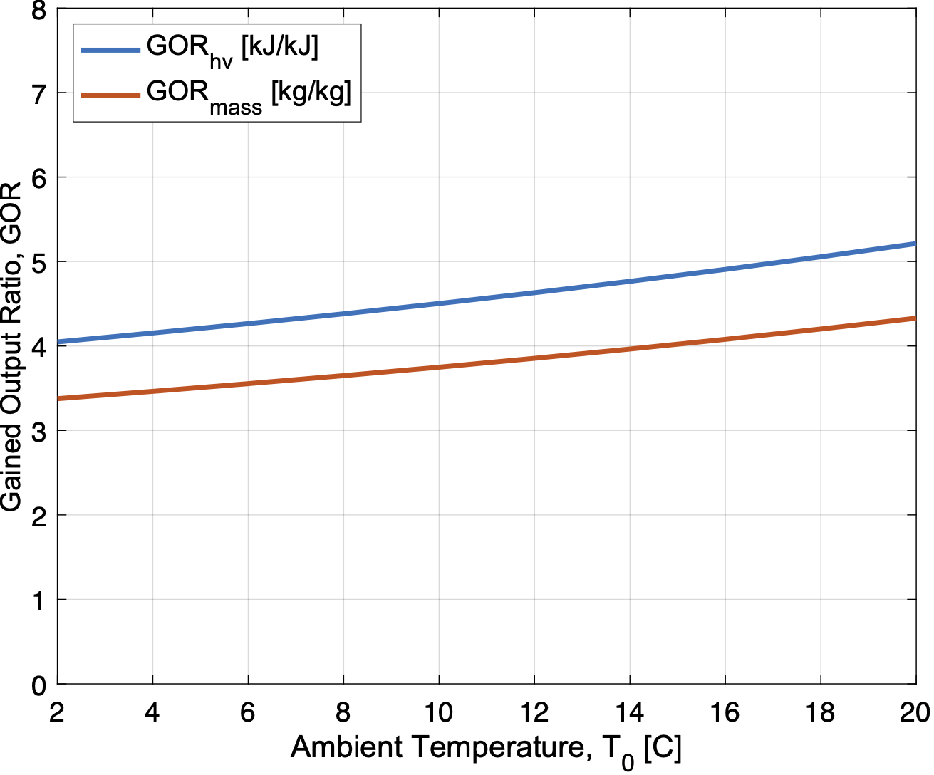

Slide 24
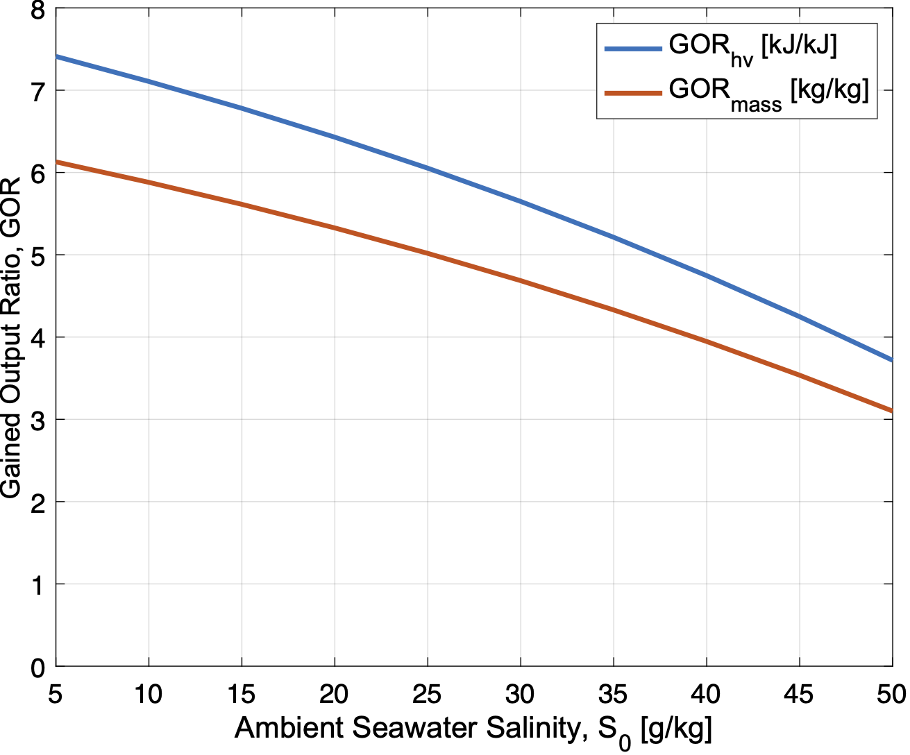
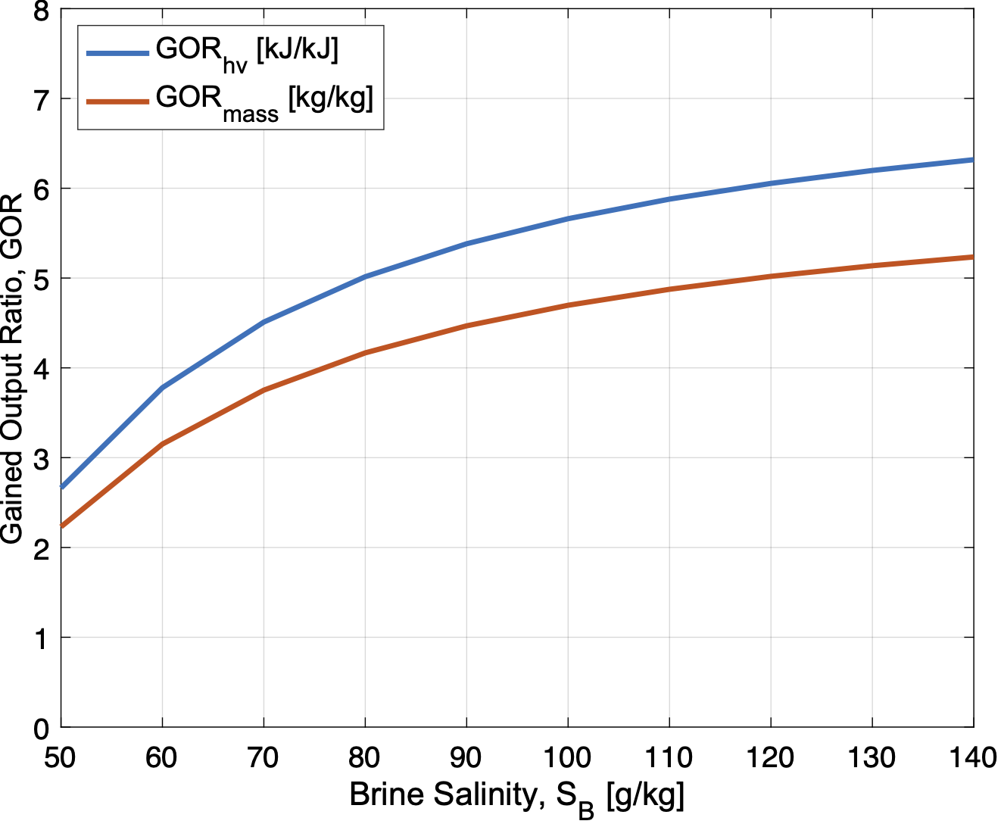

Slide 25
MED Intake Pump Specifications
Assumptions
300 [m] pump length
Pumped from seawater surface
3.4 [m] inner diameter
Concrete pipe
Specifications
Pump Head: 0.53 [m*H₂O]
Flow Rate: 16.896 [m³/s]
Pump Power: 113.559 [kW]

