Slide 1
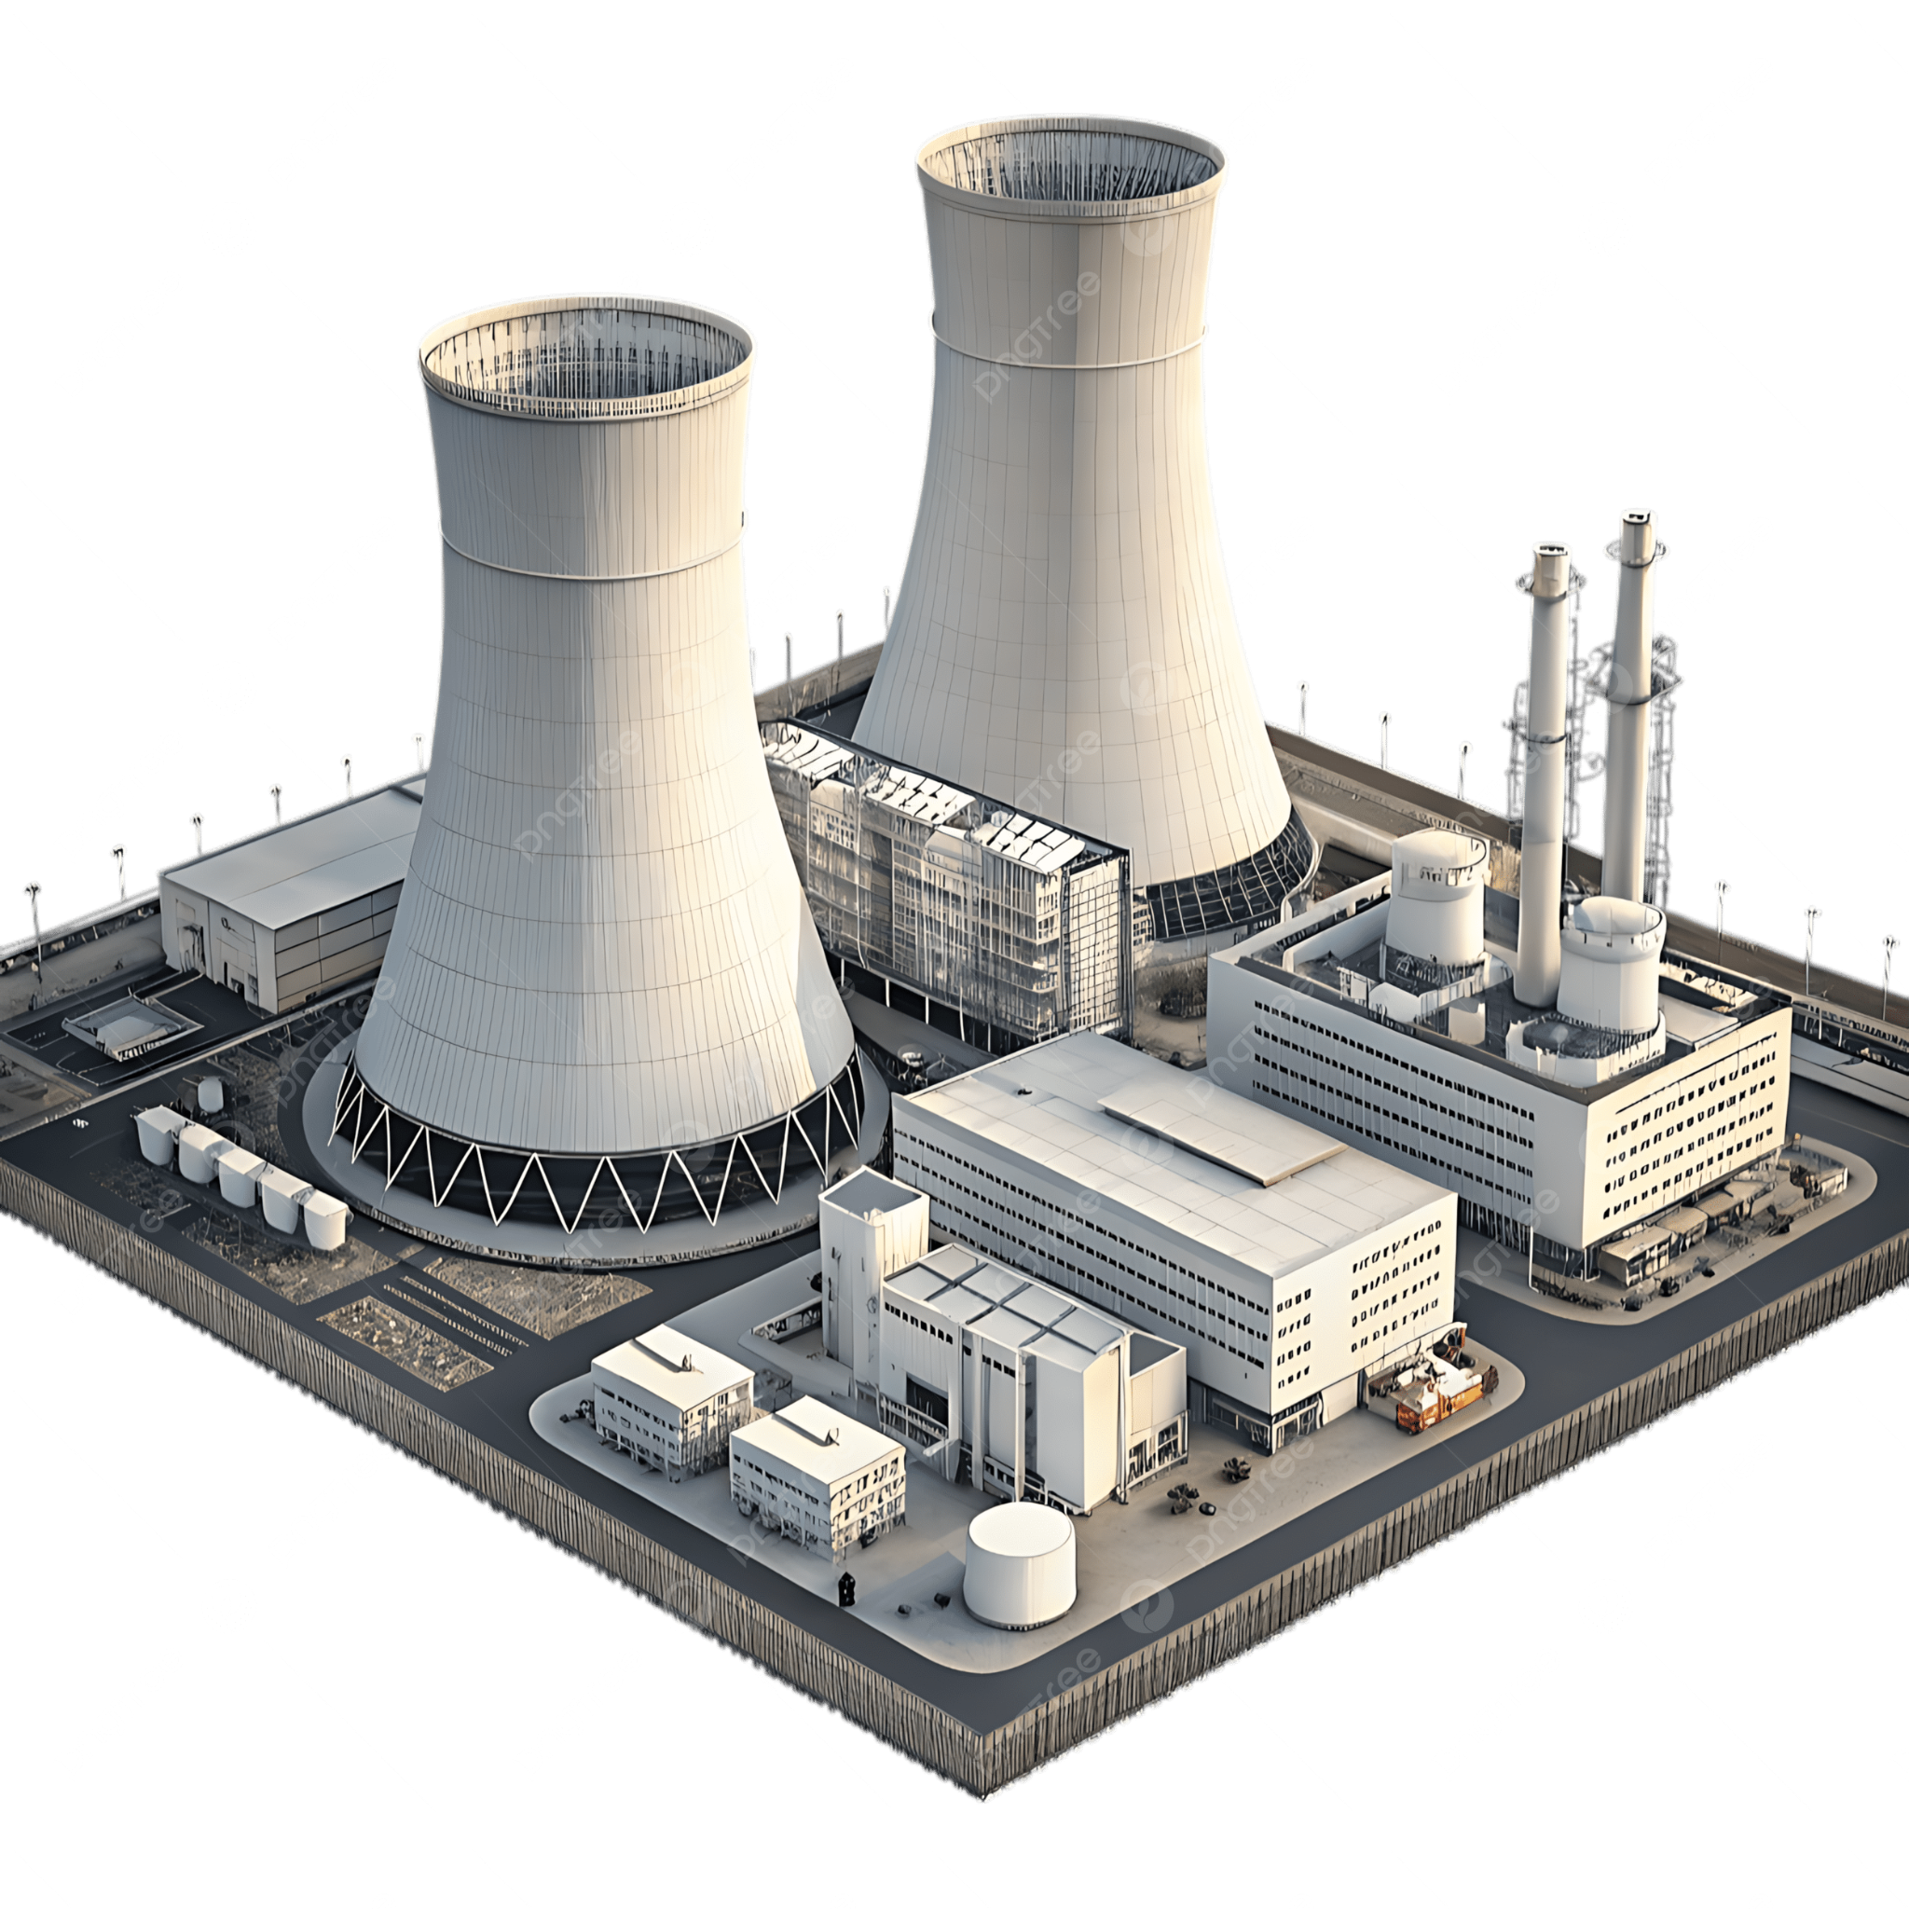


Nuclear Desalination
Using waste heat from nuclear
power plants to produce fresh water
Andrei Khazatsky, Jeremy Kwok, Joe Rosselli, Matthew Bell

Slide 2
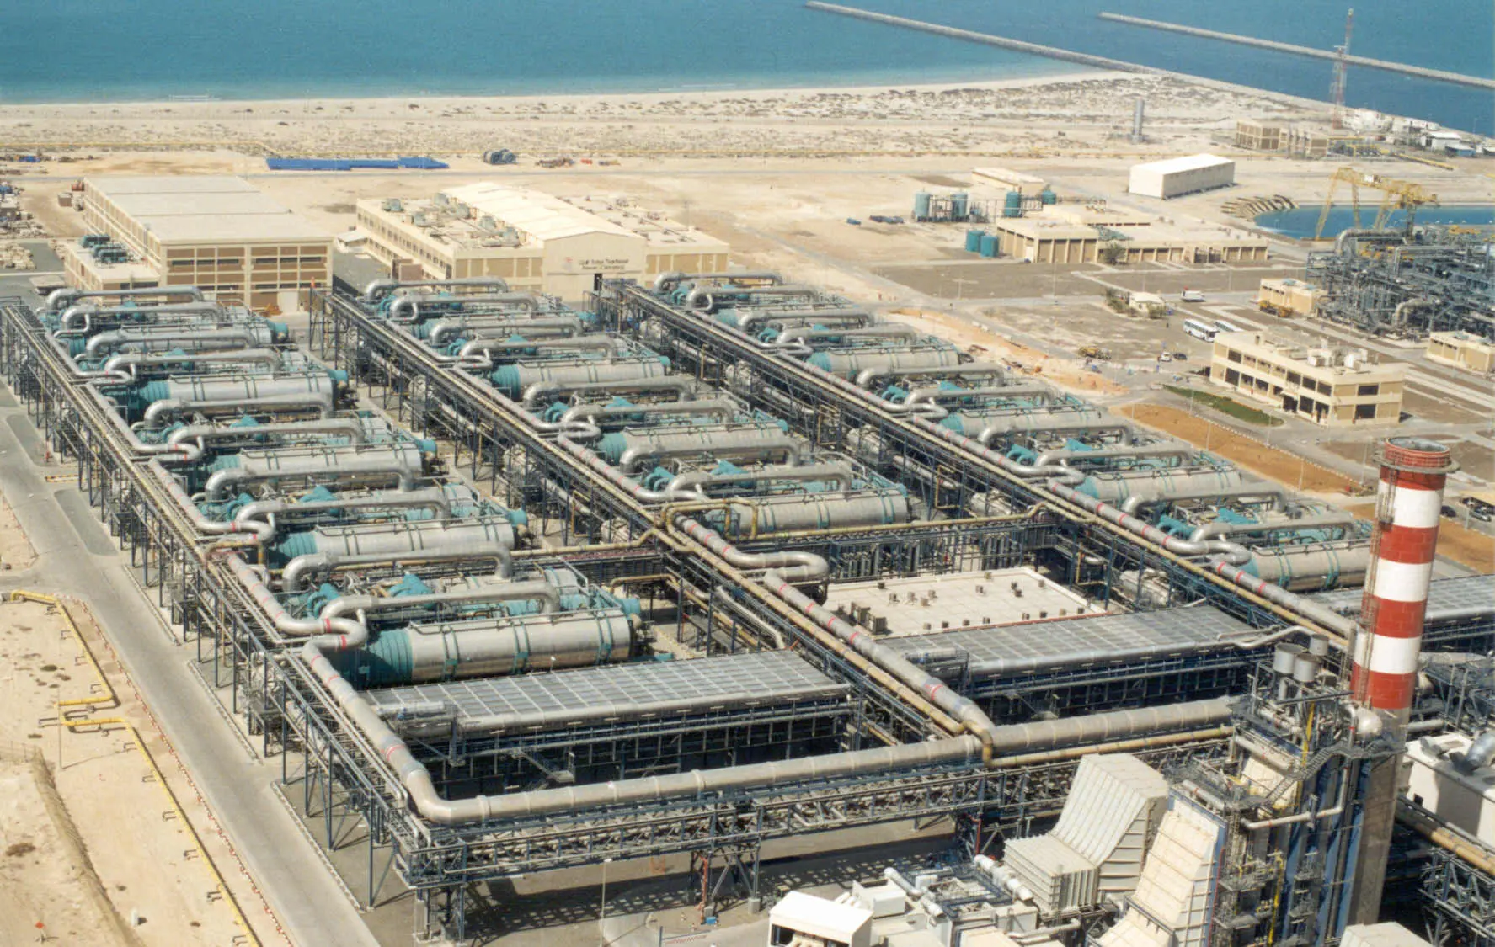
Motivation and Benefits
Freshwater scarcity is a mounting issue, desalination can address this.
Currently, desalination predominantly relies on fossil fuels, contributing to greenhouse gas emissions and unsustainable energy use.
Current Approaches:
Nuclear desalination often extracts steam from the nuclear power cycle to drive thermal desalination processes, which reduces the electricity output of the plant.
Goal: Model desalination that only uses waste heat from a nuclear power cycle.
Ras Al-Khair Power and Desalination Plant, Saudi Arabia
Notes:
Freshwater scarcity is rising with climate change and industrial demand, especially in arid coastal regions like California and parts of the Middle East where cities don’t have reliable local freshwater supplies. Desalination can help, but today it’s mostly powered by fossil energy, and extracts steam from the power cycle, cutting electricity output. Our idea is to tap into waste condenser heat, so the grid output stays intact while we generate water.

Slide 3
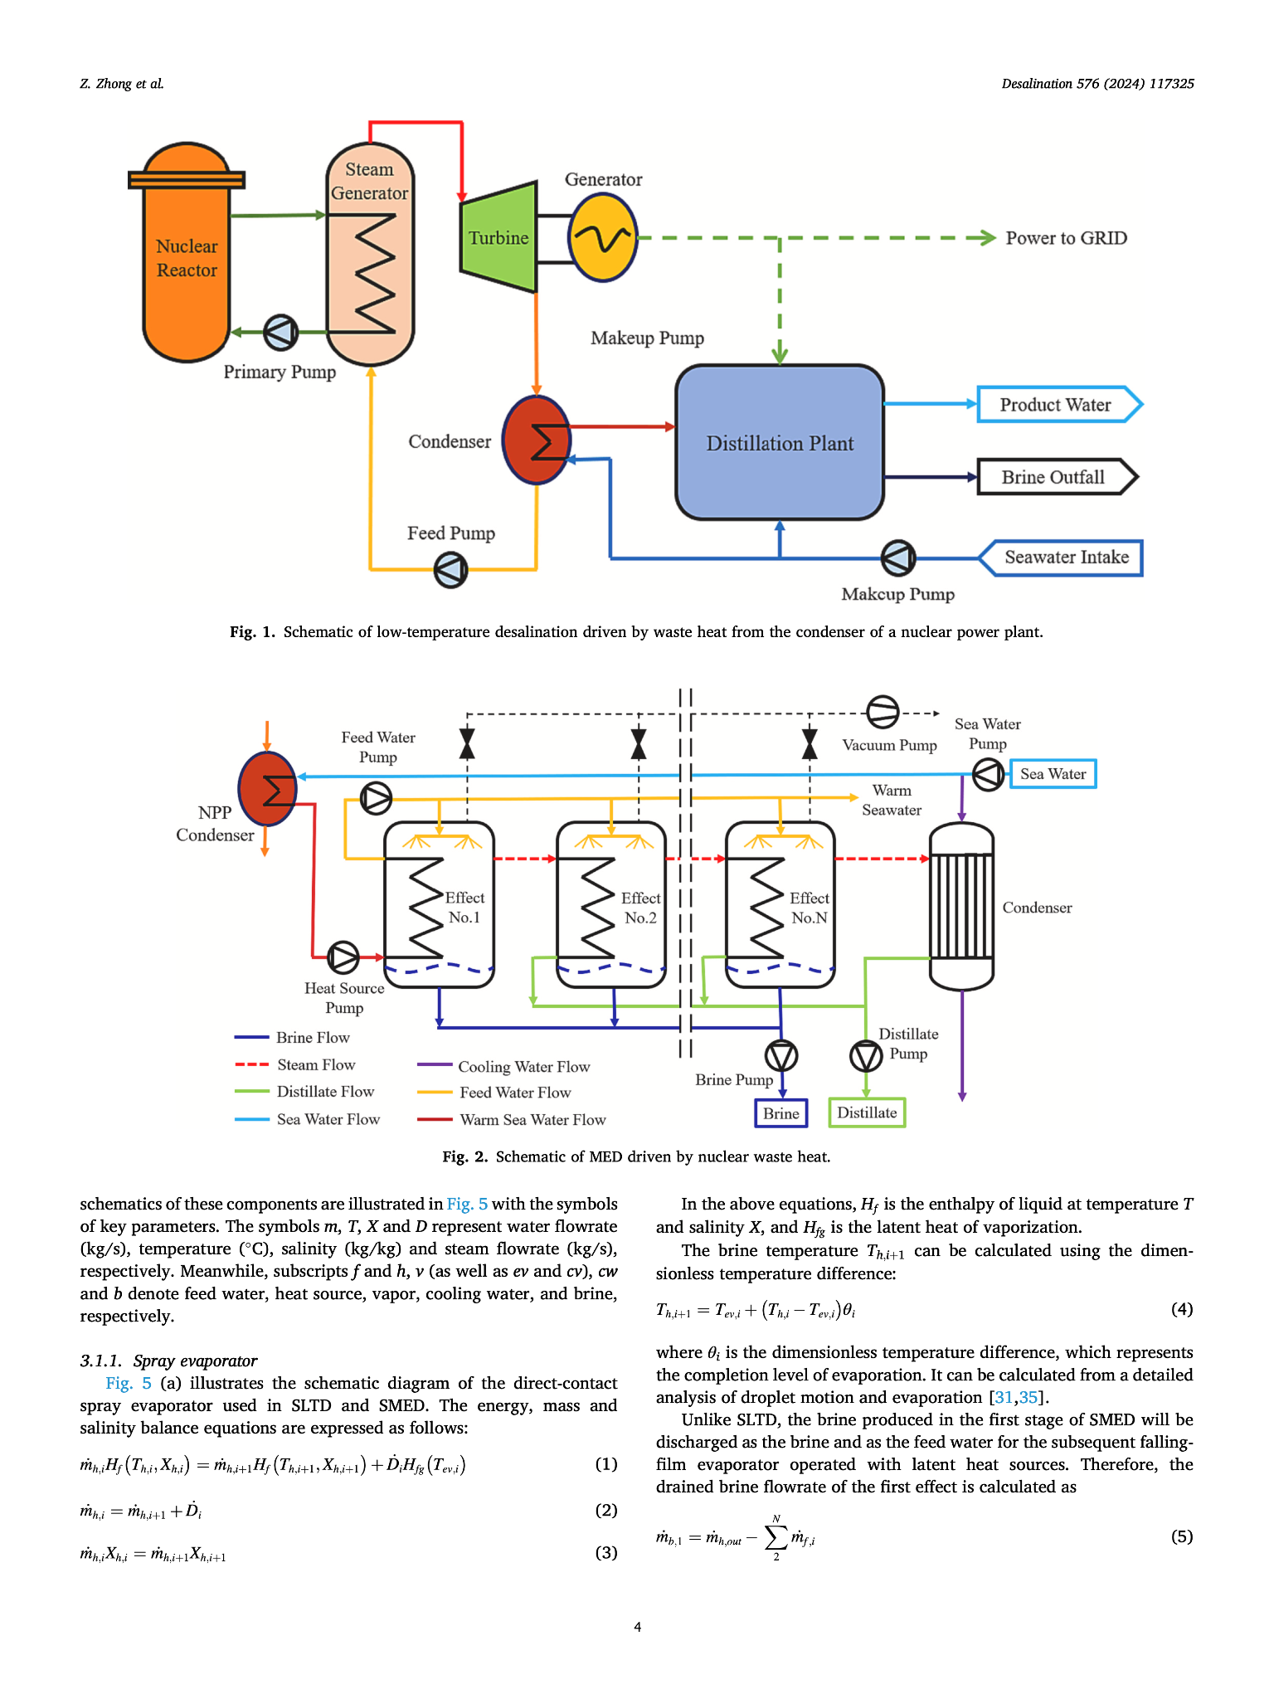
Overview of design

Slide 4
Overview of design
Let’s zoom in

Slide 5
Overview of design
Many ways desalinate water, but since we’re using waste heat, it must work with low temperatures.
Multi-Effect Distillation (MED)
Spray-assisted Low Temperature Desalination (SLTD)
Spray-assisted Multi-Effect Distillation (SMED)

Slide 6
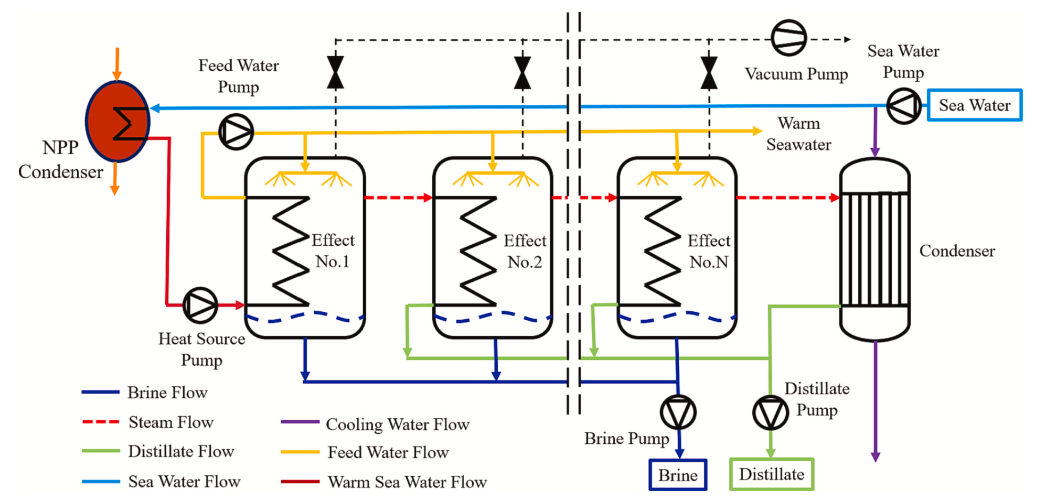
Multi-Effect Distillation (MED)

Slide 7
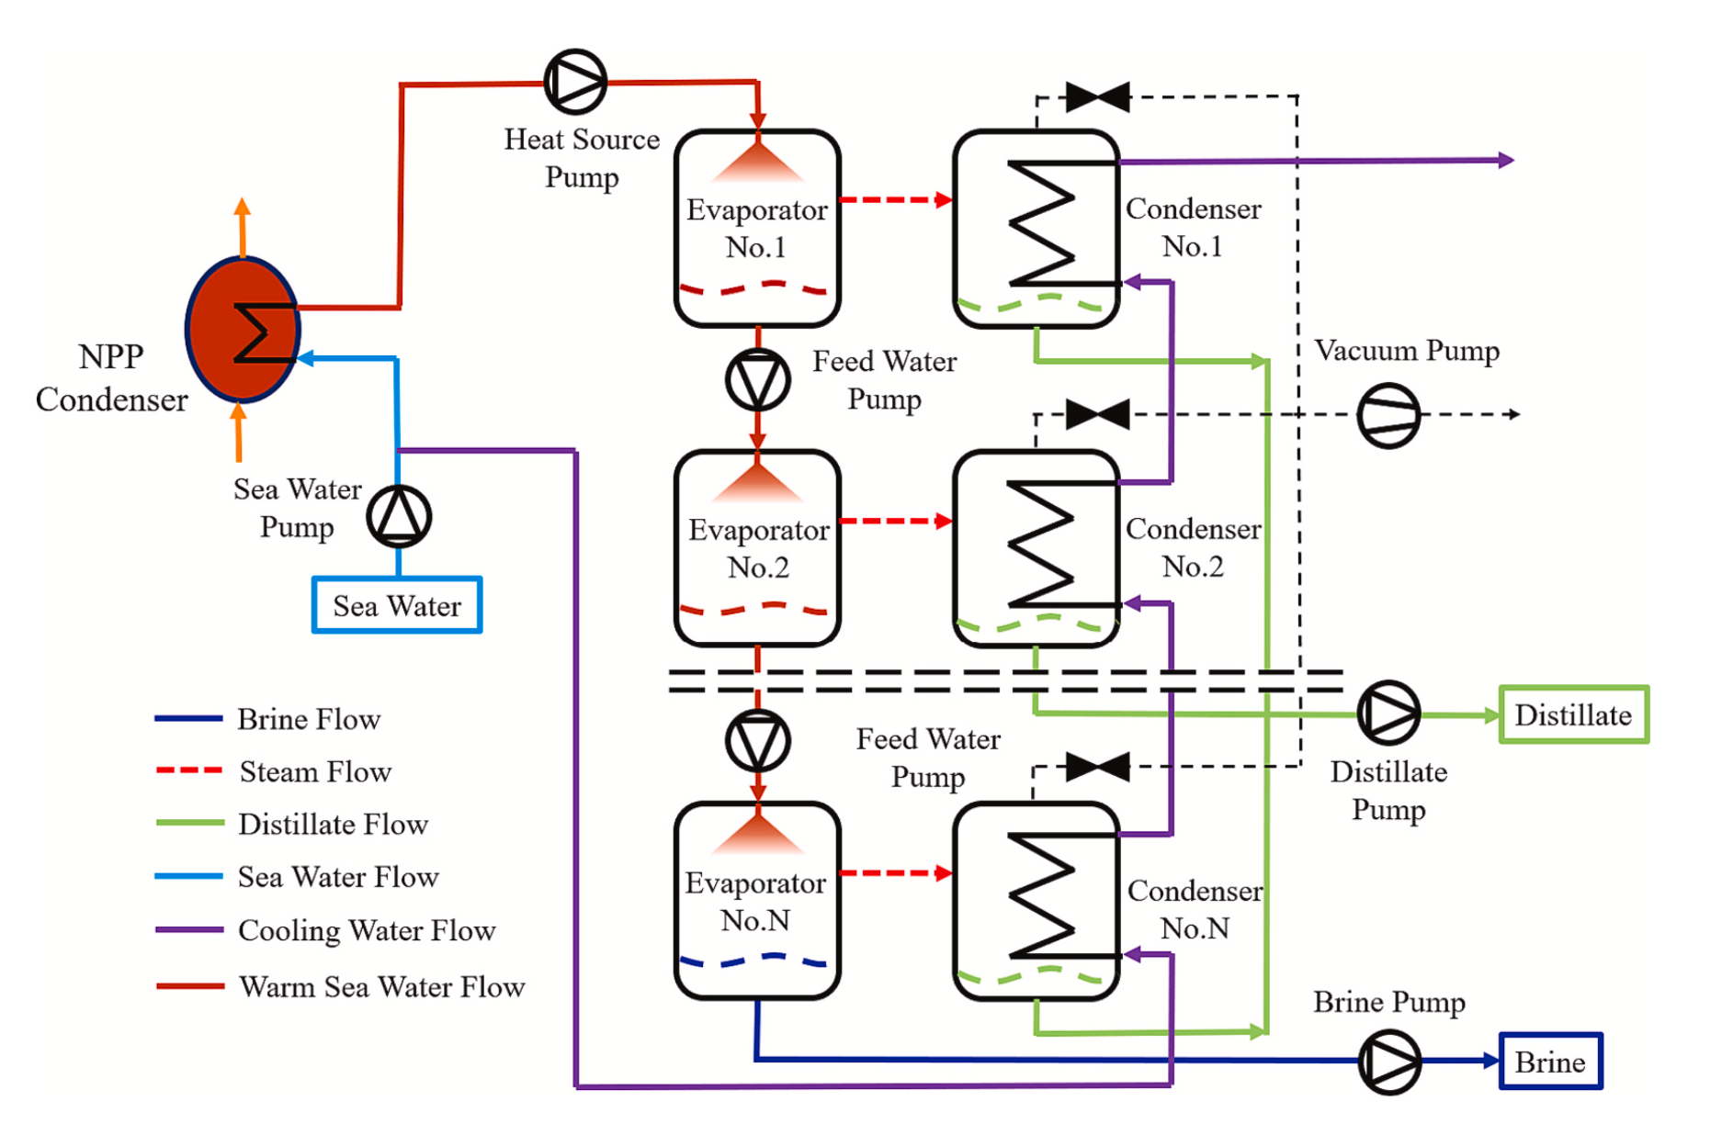
Spray-assisted Low Temperature Desalination (SLTD)

Slide 8
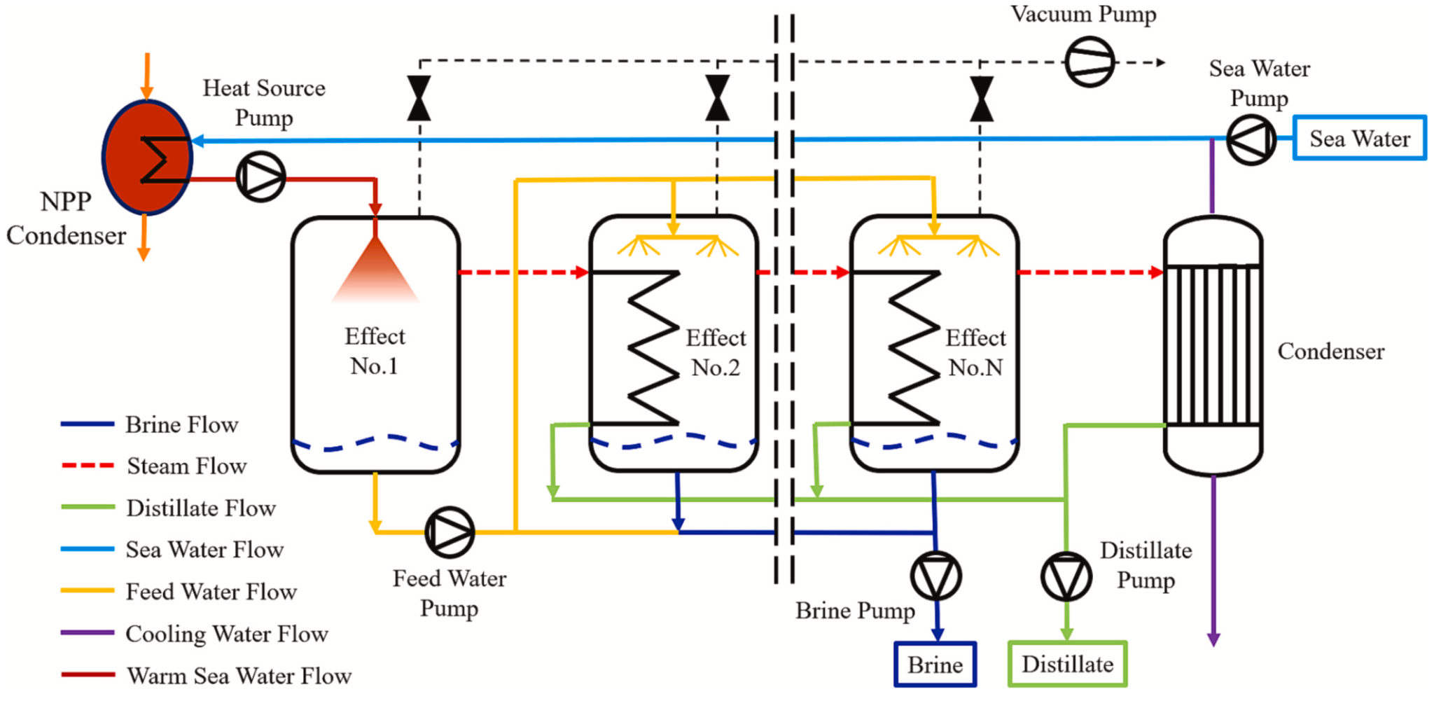
Spray-assisted Multi-Effect Distillation (SMED)

Slide 9
Expected Analysis
Compare and analyze the three methods of desalination.
Performance Metrics:
Gained Output Ratio (GOR)
2nd Law Efficiency
Levelized Cost of Water (LCOW)
Parametrization:
Cooling water flow rate
Number of effects
Heat transfer area
Waste heat temperature

Slide 10
Questions?

